Slide 1
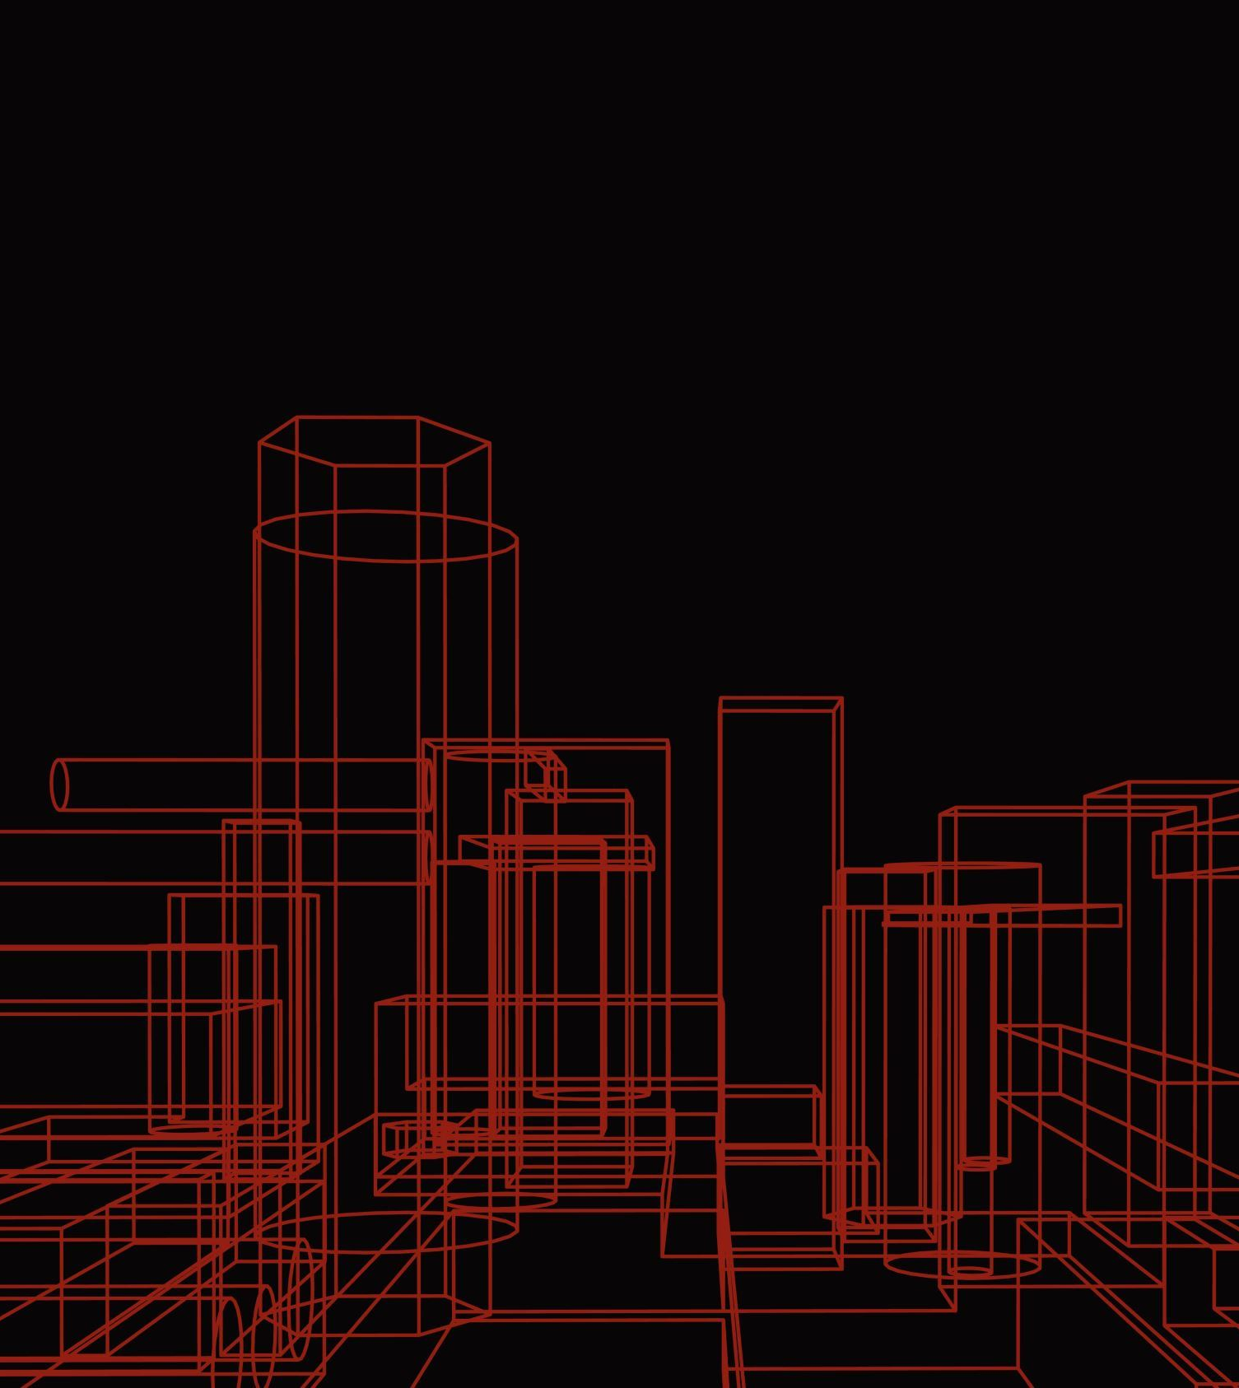
19EC071_Lakshminarayan_shrivas_EC456_Summer Internship - II -temp

Slide 2
This is to certify that the report entitled “Monocular depth estimation” is a bonafide work carried out by Lakshminarayan Shrivas , Bhavesh Kumar , Utsav Bhojani under the guidance and supervision of Prof. Hardik Modi for the subject Summer Internship - II of 7th Semester of Bachelor of Technology in Electronics & Communication at Faculty of Technology & Engineering – CHARUSAT, Gujarat
Under the supervision of, Department of Electronics & Communication C.S.P.I.T., CHARUSAT- Changa, Gujarat

Slide 3
ABSTRACT
Monocular depth measurement from red-green-blue images is a well read problem with computerized detection that has been extensively investigated over the past decade using Deep Learning Methods
Measuring depth from two-dimensional images plays an important role in a variety of programs that include scene reconstruction, 3D visualization, obstacle avoidance, autonomous vehicles and private driving
This study provides a comprehensive overview of this research topic including problem representation and a brief description of traditional methods of measuring depth

Slide 4
ACKNOWLEDGEMENT
I would like to express my sincere thanks to my internal guide Prof. Hardik Modi for his valuable guidance, enthusiastic attitude and encouragement throughout the period of Summer Internship - II and Report work
His guidance, suggestion and very constructive appreciation have contributed immensely to the evolution of the Internship
I would also like to express my sincere gratitude and sincere thanks to Dr. Trushit Upadhyaya HoD, Department of Electronics and Communication Engineering, Charotar University of Science and Technology, Changa for providing me the opportunity to undertake such a challenging and intellectual work

Slide 5

Table of Contents

Slide 6

Monocular depth estimation

Slide 7
1.1 INTRODUCTION
Monocular depth estimation is a widely discussed topic in the field of computer vision due to its potential strength in a wide range of applications, including autonomous driving, 3D reconstruction, robotics, and medical imaging
Due to the nature of 2d images, it is difficult to measure the depth of a scene since they do not retain temporal or spatial information
While multi-view geometry methods can produce accurate results, the downsides include their processing speed and large memory requirements; monocular depth estimation may address all of these problems
However, there is a lack of information regarding the necessary depth features, so it may prove to be difficult to effectively estimate depth on a monocular plane

Slide 8
1.1 INTRODUCTION
In addition, there are specialized sensors that can generate multi-dimensional depth maps with high accuracy, such as LIDAR based sensors, but this is an expensive and time-consuming approach because these sensors generally require high computational power and, thus, quite inadequate memory, making them less suitable
In recent years, the methods that are used for monocular depth estimation have improved, and the publicly accessible dataset has also enhanced their performance
Convolutional neural networks have shown very effective results through advancement and development

Slide 9
1.2 Objective
An important and frequently debated issue in computer vision is monocular depth estimation, which includes maintaining 3D information in 2D images, which is a difficult process
Our goal is to demonstrate one such scenario where monocular depth estimation is used in the real world, using a mono vision camera like one that may be found on a computer or laptop, known as the webcam
Recent developments have seen some good and accurate findings
As this system or model will be running on a central processing unit, it does not allow the incoming graphics to process as it should, so the decrease in frame rate is unavoidable
Our goal is to produce a respectable grade depth map from 2d images with a frame rate of 2-7 fps

Slide 10
1.2 Objective
We also aim to estimate the distance between the camera and the human face and to detect faces in incoming video, we also aim to measure the distance between the camera and the human face
By taking the use of this reference distance we will determine the variable distance between our face and the camera in real time

Slide 11
1.3 Motivation
The advancement in computing power and processing power has led to the development of novel technologies which are making breakthroughs in the field of computer intelligence
Monocular depth estimation is one of those applications
This project is motivated by our desire to understand and implement one of these applications in the real world, given the speed at which research is conducted today, it seems very likely that computer vision will be the main focus of autonomous vehicles in the future

Slide 12

CHAPTER 1

Slide 13
Image formation in camera
The human eye will focus on the sharpest visual scene to gather information and objects that stand out in an image
Moreover, different cells inside retina will react to absorbing light in a different way, which helps our brain construct images
Image formation in camera is an interesting topic because it can make us think about how our brain perceives images as well as causes a fascinating illusion Images can be formed by the sensors in the camera or by optical devices such as mirrors, lenses, or prisms
The three major processes involved in this theory are Reflection-absorption theory can be present in cameras, too
Today, camera lens are merely evident and recognizable tools for capturing clear photographs in a variety of shapes and sizes

Slide 14
Image formation in camera
Another important operation for these lenses is to convert the collection of light waves that travel through the lens aperture and hit the camera's film or digital sensor into an image
The opposite happens as one moves closer to what’s being photographed

Slide 15
Working
CCD is short for charge-coupled device
It is an image sensor and, like other sensors, it captures values ​​and converts them into an electrical signal
This CCD is actually shaped like an array or rectangular grating
Each CCD array sensor is itself an analog sensor

Slide 16
Chapter 2

Slide 17
Deep neural networks
Input layer: The input layer, which includes passive neurons, is the primary layer of a neural network
Hidden layer: This is the core layer of our neural network, where all of the critical mathematical stuff takes place
Weight: Weight allows a neuron to focus on or prioritise an input feature
Bias: Bias is basically a numerical value in general it is 1 which will be added to the sum of weighted input that is our weight multiplied to input values and then a bias which is value 1 is added to this weighted input values

Slide 18
Literature Review

Slide 19
1.1 Datasets for depth estimation
KITTI: The KITTI data set is the most commonly used reference for exterior scenes taken from moving vehicles
Make3D: The Make3D dataset is another open source dataset for deep learning-based monocular depth estimation
NYUD V2: The NYU-Depth V2 data set is composed of video sequences from a variety of indoor scenes as recorded by both the RGB and Depth cameras from the Microsoft Kinect
Pandora: The Pandora dataset is used for head pose estimation with head localization and pose estimation on depth images
SceneFlow: The SceneFlow dataset introduce first large-scale datasets for training and validation of scene flow models

Slide 20
1.2 Deep learning methods and monocular depth estimation
As we have discussed earlier monocular depth estimation has become an important aspect for various applications and also there has been significant advancement in learning-based monocular depth estimation approaches and methods in some previous years like show in papers, as we have observed most of this methods utilized convolutional neural networks which requires training with pre made datasets that contains RGB images with additional depth information

Slide 21
1.2 Deep learning methods and monocular depth estimation
Supervised learning approaches require some good quality of data with pre calculated depth information with the image to train and it can output the depth information instantly, Although the dataset required is huge and it becomes really hard and expensive to collect such dataset with accuracy
To solve this problem of supervised learning there has been many semi-supervised learning methods developed in past years which has come to be really helpful as they only require a limited number of training images with depth information and a large number of unlabeled data for training

Slide 22

1.2 Deep learning methods and monocular depth estimation
The training for this network is done by augmenting depth images by flipping and applying color distortion, but it also limits the generation of depth maps upto 128 X 160 PX resolution where compared it to the other state of the art methods also if we look into the network it seems to be biased in the output because of the Hilbert maps densification process which may hinder in the depth

Slide 23
1.3 Evaluation matrices for measuring performance of methods
Here, we are listing some of the common matrices which were used for evaluating the performance fo the above methods and architecture which is also useful in comparing the models with each other to rank the performance
We can describe these matrices as Absolute Relative Difference, Root Mean Square Error, Root Mean Square Error log and Square Relative Error or SqRel, for comparing all the methods there are publically available pre-trained models available which we can take in use now by using the pre-trained dataset we can actually measure a more generalized performance of our architectures on different testing sets

Slide 24
1.4 Matrices for evaluation of the methods
Here di is the real ground truth pixel depth and di* is the predicted pixel depth and we are using the above equations for evaluating the different models discussed above majority of which use KITTI and NYUD – v

Slide 25

Software flow diagram

Slide 26
1.1 Architecture
As seen in the architecture of the vision transformer above, we use the embedding layer for creating the images patches or the tokens which our transformer maintain throughout the computation process
As we know in ViT this tokens maintain one to one relationship with other image patches so it means it can also maintain the spatial resolution in the embedding layer throughout the transformer steps
This also aims to maintaining the initial receptive field in embedding, this lets to increase overall receptive field as features pass from consecutive sampling and convolutional layers

Slide 27
1.1 Architecture
As the architecture shows the input image is converted into tokens, either by using a ResNet-50 feature extractor or by extracting patches that do not overlap which is then been flattened
In the embedding process the image is augmented with positional embedding and patch-independent readout token then added to it

Slide 28

1.1 Architecture
This network is basically inspired by the work presented in of which they represent several variants this network consumes the ViT-Base in this they use patch-based embedding technique and features with 12 transformer subsequent layers, similarly their other work ViT-large which uses the same configuration as above but it has 24 transformer network layer and a wider feature size and one more configuration which use ResNet50 architecture for computing embedding of image with same 12 transformer configuration

Slide 29
Test Results and discussion
We have aimed to predict depth man form a single frame or the sequence of frame which is a video from a monovision camera as our goal and we have been successfully executed the program for that we have tested the model indoor and outdoor but it seems that indoor results seems to be more accurate and understandable from a viewpoint of a laymen so we will be attaching the image of indoor view also we have implemented another method where we are also calculating the distance of my or a human face from the camera by taking in the use of a simple geometry formula which then quite accurately predicts the distance from the camera and the face as we have measured using a measuring tape in real time and we can say that there is a some fluctuation but overall we are satisfied with the test results

Slide 30

Test Results and discussion
Our model uses pre-trained weights for estimating the depth from single image as training a deep neural network which is in research domain right now with all that complexity it becomes quite hard to train and implement also for training purpose we require to download hundreds of gigabyte of data which is not in out capacity and then we require a high end graphics processor for training out neural network which then can predict accurately so taking all this things in account we have decided to use pre-trained weights which is more easy to embed and work with and we have also gone through out the network to understand each and every aspect of it

Slide 31

Test Results and discussion
We are listing the comparison image side by side we have plotted while running our model The image in the left windows show the real video that is being captured from the monovision camera or the web cam which is embedded on my laptop and also distance of my face from the camera can be seen in real time and it increase or decrease in real time based on the location of the human face, right side is the depth map which is being generated from the left side image we have aimed to get more then 8 to 10 frames per second but due to computational limitation we were able to only reach max 5 frames per second

Slide 32
CONCLUSION
An Throughout this project we have learned and understood that convolution neural networks have the ability to predict depth information from a single image which is really helping us in understanding the scene or the environment more accurately which is eventually going to lead to development of certain breakthrough technologies which will be helping and advancing the human life for betterment, we have seen the implementation of this technologies in various sectors and analyzed the overall impact that will we created if applied in certain applications like autonomous driving vehicles or the military drone which can save lives by exploring the unknown area where humans cannot go or reach by giving the ability of depth to a computer machine we are making it more advanced like humans although the algorithms are not that advanced or may not be that fast and efficient but in future research work it will be more rich and faster in computing the depth

Slide 33
CONCLUSION
Although the only issues with using complex deep neural network is their memory requirements which can an expensive problem while we deal with high-resolution images and when we aim to predict depth maps with high resolution, same goes with the computational power however if we can develop some lighter deep neural network architectures it will be much more efficient and less time consuming will be less expensive and can be developed at consumer level market
We aim to see the development of many more such datasets and also self-adoption methods which can adapt themselves in accordance with the scene conditions

Slide 34
REFERENCES
Reference from Literature review

